Slide 1


Sanjivani Rural Education Society’s Sanjivani College of Engineering,Kopargaon-423 603 (An Autonomous institute, Affiliated to Savitribai Phule University, Pune) NAAC ‘A’ grade accredited ,ISO 9001-2015 Certified
Department Of Computer Engineering
Subject- IOT (Internet Of Things)
Group Members
Sr.No | Name | Roll No
1 | Parjane Prasad | 111
2 | Pathak Kunal | 112
3 | Pathan Saniya | 113
4 | Patil Rahul | 114
5 | Pawar Rohit | 115
Guided By – Prof.J.Eshwari

Slide 2

IoT Based Smart Plant Monitoring System
This system simplifies plant care using IoT technology. It integrates soil moisture, temperature, humidity, and motion sensors with a NodeMCU ESP32 microcontroller.
Data is transmitted to the MIT app via Wi-Fi for remote monitoring. The system automatically waters plants when soil moisture drops below threshold levels.

Slide 3
Why Plant Monitoring Matters…?
Plant Health Essentials
IoT Benefits
Monitoring water, temperature, and humidity ensures optimal growth. It prevents diseases and promotes efficient resource use.
IoT technology offers real-time monitoring and remote access. It automates actions and provides valuable data insights for better plant care.

Slide 4





Project Goals & Scope
Monitoring
Real-time tracking of soil moisture, temperature, humidity, and motion.
Automation
Automatic watering based on soil moisture levels.
Remote Access
Monitor and control via the Blynk app from anywhere.
Data Insights
Collect and analyze environmental data for optimal plant care.

Slide 5
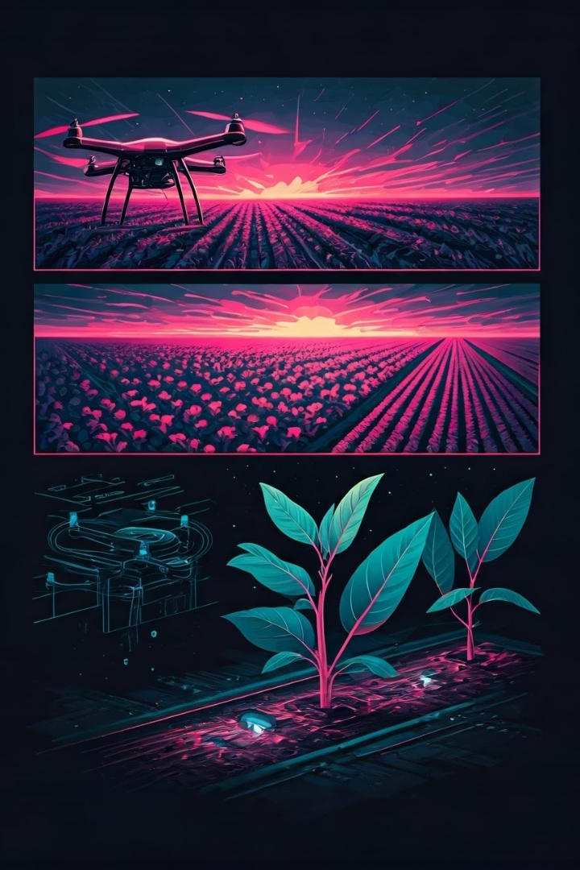



Current Technology Landscape
Smart Plant Monitoring Systems
Use sensor networks to monitor plant health parameters. Limited by high costs and complex setup.
IoT Plant Health Systems
Integrate sensors with IoT for real-time data. Depend on stable internet connections.
Advanced Technologies
Include UAVs, Wireless Sensor Networks, AIoT, and Cloud Computing for agricultural applications.

Slide 6
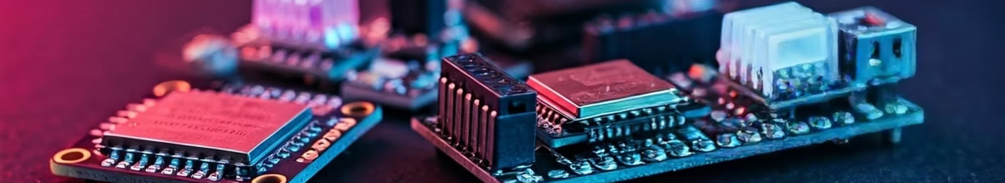
System Components
NodeMCU ESP32
Soil Moisture Sensor
Open-source IoT platform with built-in Wi-Fi. Features 16 digital I/O pins and 4 MB flash memory.
Measures water content in soil. Operates at 3.3V to 5V with analog interface.
DHT11 Sensor
Additional Components
Measures temperature (0-50°C) and humidity (20-90%). Operates at 3.5V to 5.5V.
Includes PIR motion sensor, relay module, water pump, and Blynk app for control.

Slide 7
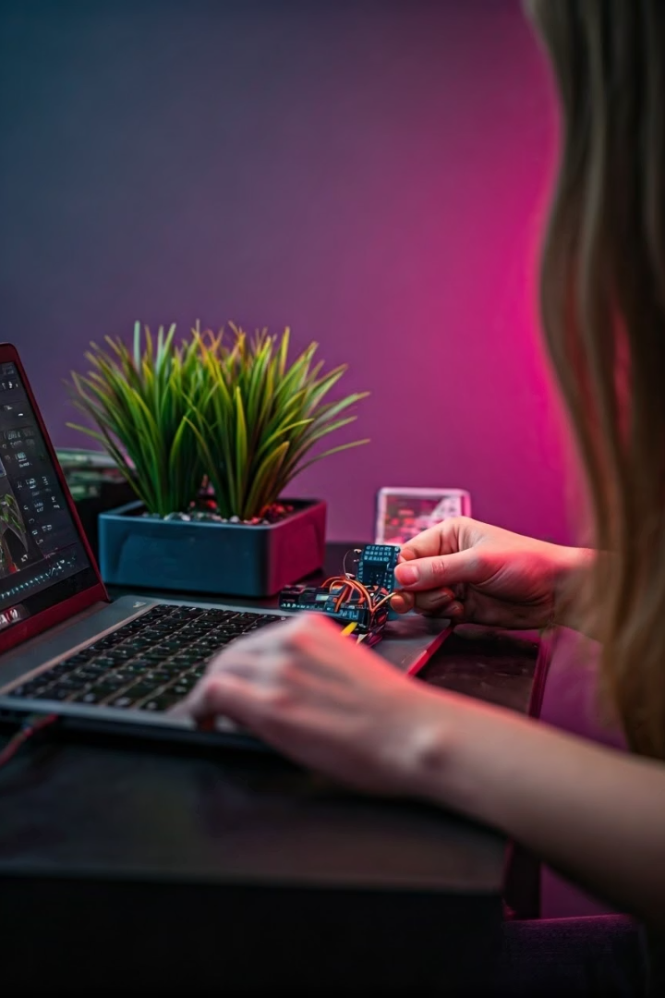
Hardware & Software Setup
Hardware Assembly
Connect sensors to NodeMCU according to the circuit diagram. Ensure proper wiring between components.
Software Installation
Install Arduino IDE and necessary libraries. Write and upload code to NodeMCU.
MIT App Inventor Configuration
Create a new project in MIT app. Add widgets and set up virtual pins for data transmission.

Slide 8
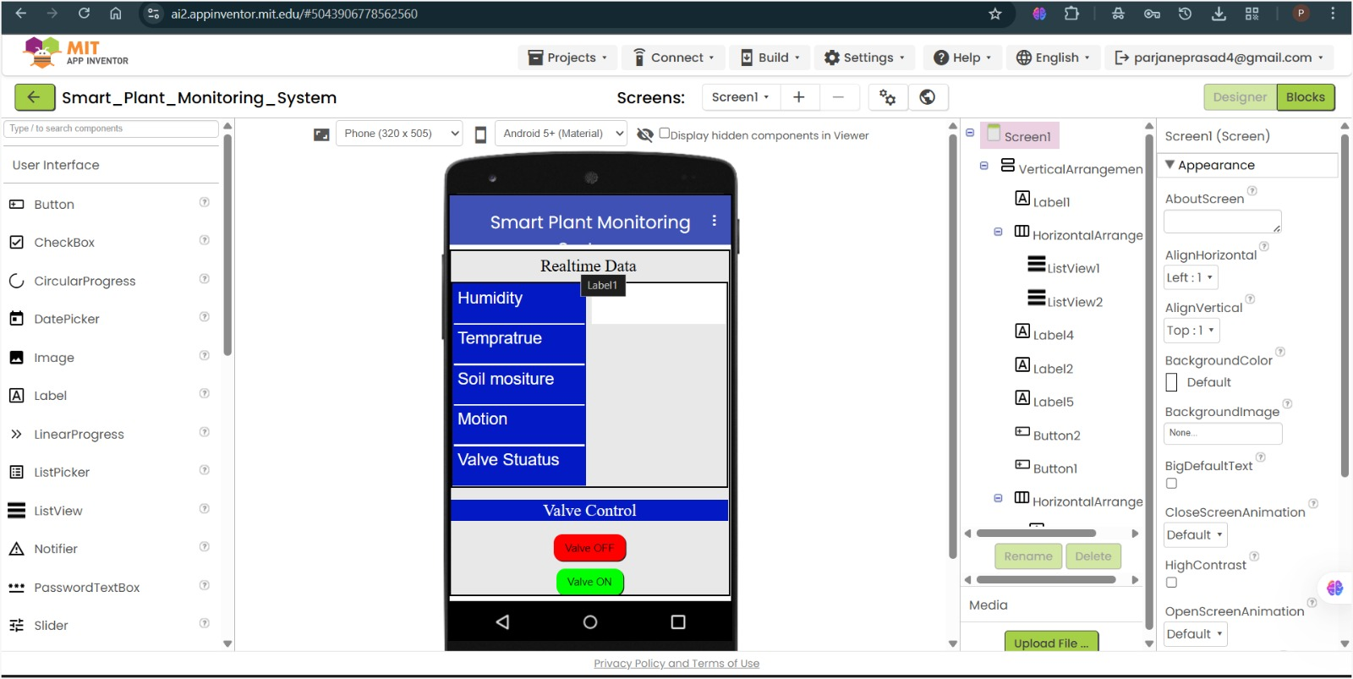
APK(app) Interface

Slide 9
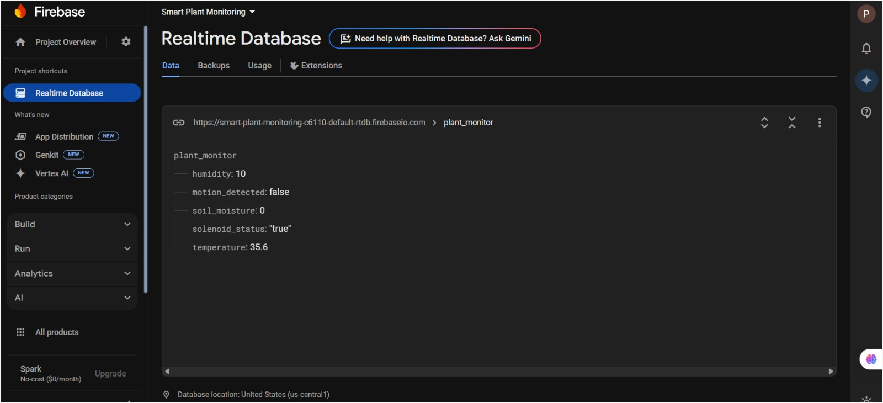
Real-time Database using Firebase

Slide 10
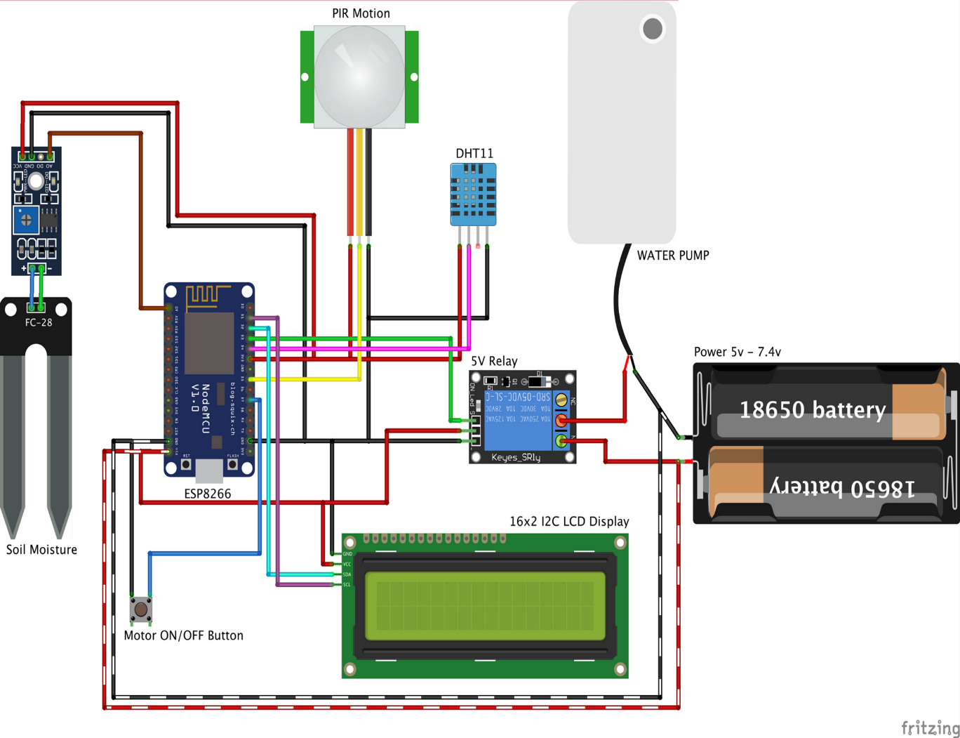
Block Diagram Circuit Diagram: Include a detailed circuit diagram showing the connections between the components.

Slide 11
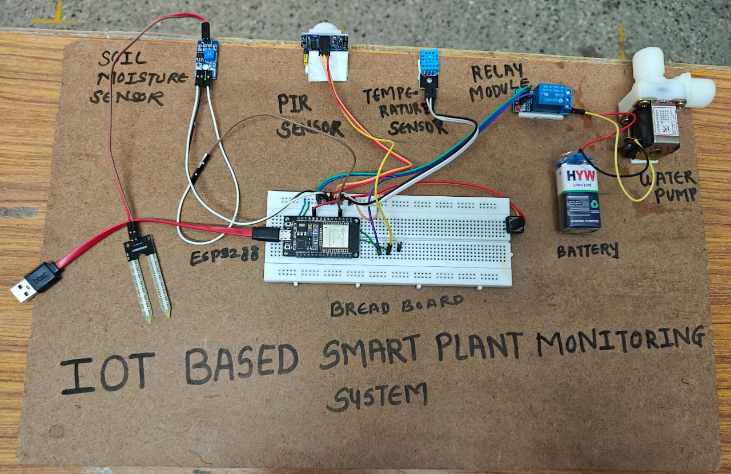

Slide 12
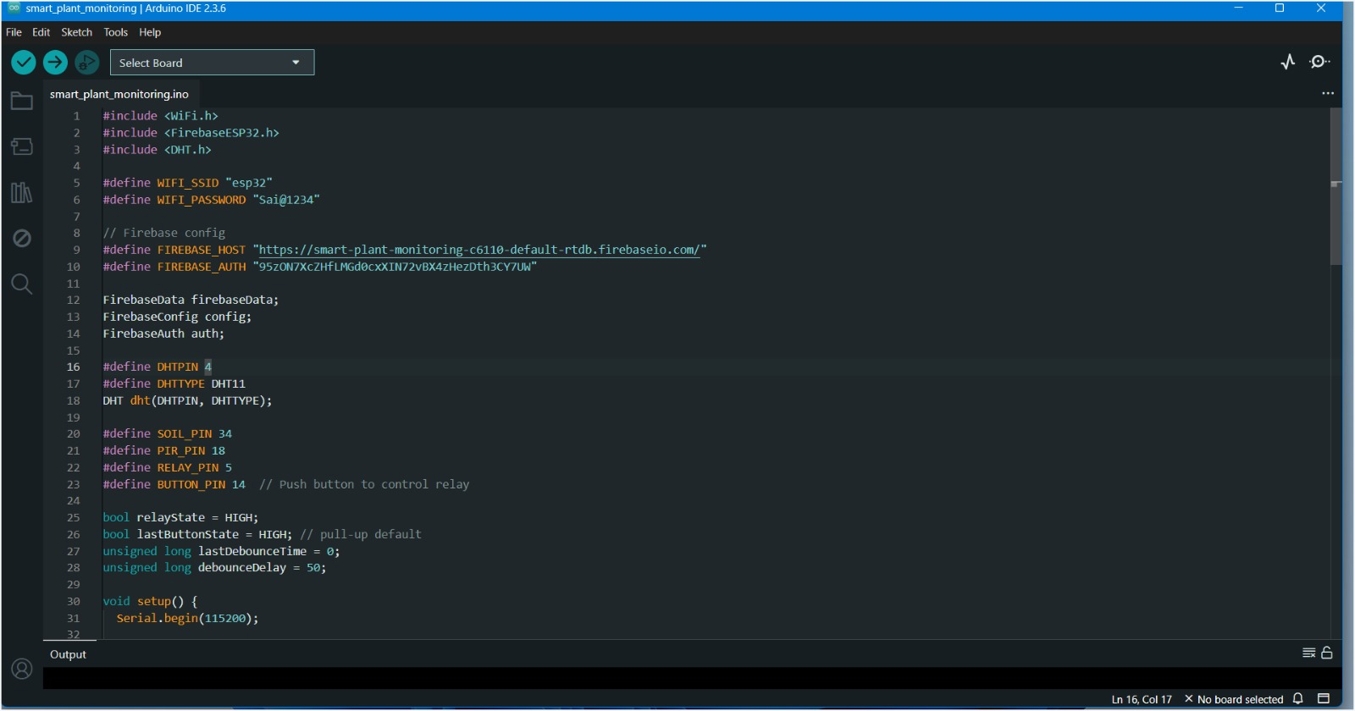




Code Implementation
Initialization
Set up libraries and define pins for sensors and actuators.
Sensor Readings
Collect data from soil moisture, temperature, humidity, and motion sensors.
MIT Integration
Send sensor data to MIT app and receive control commands.
Control Functions
Implement automated watering based on sensor readings and user inputs.

Slide 13








Testing & Results
Test Setup
Data Collection
Prepare controlled environment with various soil moisture levels.
Record sensor readings under different environmental conditions.
Performance Analysis
Automation Testing
Evaluate system response time and accuracy of sensor readings.
Verify automatic watering triggers at preset moisture thresholds.

Slide 14






Project Outcomes
Successful Implementation
System provides real-time monitoring and automation
Healthier Plants
Optimized growing conditions through precise monitoring
Resource Efficiency
Water usage optimized through soil moisture sensing

Slide 15
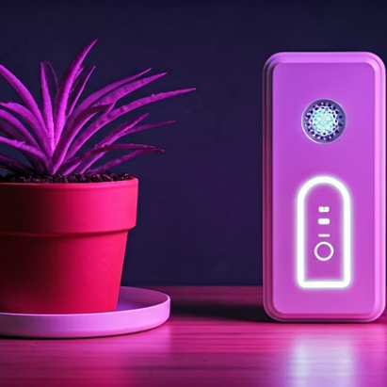
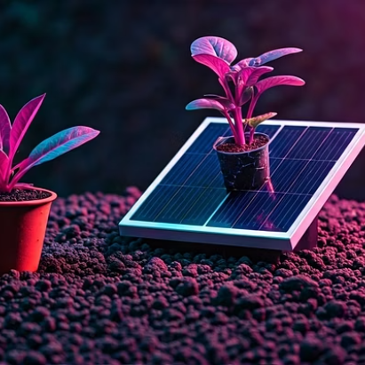
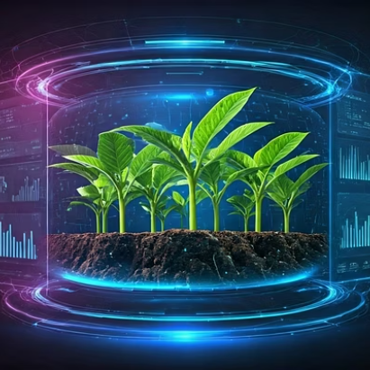
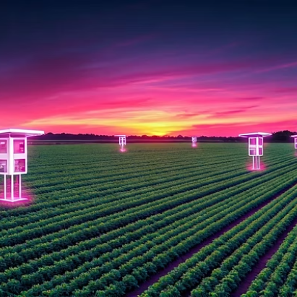




Future Enhancements
Additional Sensors
Energy Efficiency
Machine Learning
Scalability
Integrate AI to predict plant health and growth patterns.
Expand to monitor multiple plants or large agricultural fields.
Add light and pH sensors for comprehensive monitoring.
Implement solar panels for sustainable power supply.

Slide 16
Conclusion
The IoT Based Smart Plant Monitoring System aims to automate and enhance plant care using various sensors and the MIT app. The project includes monitoring soil moisture, temperature, humidity, and motion, and automating watering based on soil moisture levels. The system is implemented using a NodeMCU ESP3288 microcontroller, various sensors, a relay module, and a water pump, all integrated with the MIT app. The project successfully provides real-time data, remote access, and automated plant care, leading to healthier plants and efficient resource usage.

